Slide 1

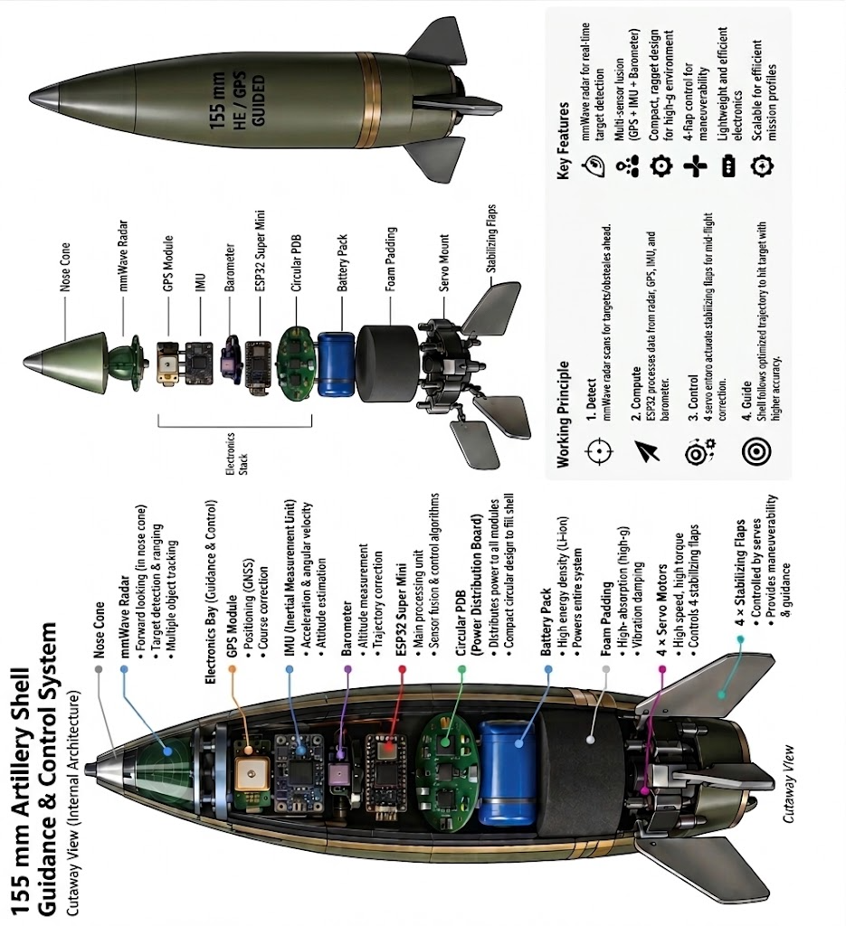
Smart India Hackathon 2026
Problem Statement ID - 98
Problem Statement Title - Development of a Low-Cost Precision Guidance and Smart Electronic Fuze System for a 155 mm Artillery Shell
Theme- Smart Vehicles
PS Category – Hardware
Team ID – R15-230
Team Name - Tenacity

Slide 2

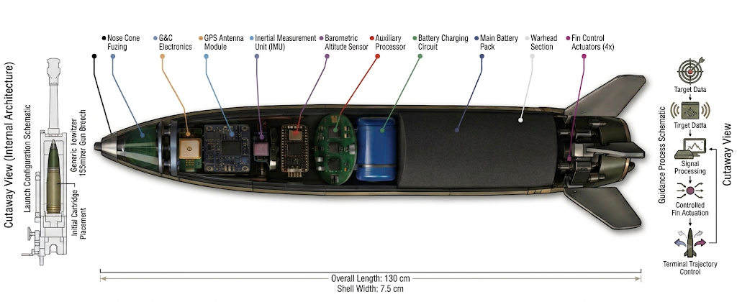
VECTOR
A PID- & ML-based Anti-Jamming SWAP-C E-stack, with power generator & Object Classifier, Servo-controlled flaps providing Aerodynamic Stabilization to a 155mm Shell Trajectory.
Detailed explanation: The E-Stack sits inside Ogive (Top cone) decoupled with the shell body and supported with ball bearings. It contains a Mems IMU, Barometer & GNSS module sending flight data to MCU which calculates the desired trajectory and corrects error in flight using servo-controlled flaps. Entire E-stack runs on power generated via stationary Coil of wire and Magnets spinning along with the shell. PID (Proportional–Integral–Derivative) and EKF (Extended Kalman Filter) are used as mathematical algorithms for error correction. A multi-spectral IR sensor classifies objects thus bypasses decoys. Custom PDB and FPC (Flexible Printed Circuits) are used covered with Epoxy Resin to handle high G-force and pressure.
How it addresses the problem:
PID and servo-controlled flaps allow shell to be on desired trajectory.
Sensor readings goes through ML model to detect Inconsistent Values and Extended Kalman Filter determines offset and best-fit value providing least possible error.
Multi-Spectral IR sensor differentiates objects (tank and bird) thus allowing proximity mode fuze.
No battery eliminating any risk of thermal or chemical hazard.
All algorithms and readings calculation happen inside a compact MCU.
Innovation and uniqueness of the solution:
Electromagnetic generator instead of battery
Custom PDB board designed for 4 servo , 1 MCU
Decoupled Ogive and Body reducing RPM from 15000 to 200
Custom PID and EKF algorithm and ML model for negligible errors
Aerodynamic Model with COP (centre of pressure) behind COG (centre of gravity)
E-stack sits inside the Ogive making it compatible with existing structure

Slide 3
Technical Approach
tenacity
Technologies used:
1) Software
C/C++
Python
2) Algorithm
PID Proportional–Integral–Derivative)
EKF (Extended Kalman Filter)
3) Communication
I2C
UART
PWM
4) Hardware
- MCU : STM32F446RET6
- MEMS IMU: ICM-20948
- Barometer : BMP388 Pressure Sensor
- GNSS : u-blox NEO-M8N
- Multi-Spectral IR Sensor : AS72651 NIR Sensor
- Servo Actuators : EMAX ES08MA II
- Bar Magnet : Neodymium N52 Bar Magnets
- Copper Wire
- Epoxy Resin
- PDB : Custom
- FPC (Flexible Printed Circuit)
Methodology and process for implementation (Flow Charts/Images/ working prototype)

Slide 4
Feasibility and Viability
tenacity
Analysis of the feasibility of the idea
Potential challenges and risks:
Under 10000 g to 20000 g of force ball bearings will not rotate due to friction giving high axial roll.
Components (like crystal oscillator) can shatter under such high launch pressure
Electromagnetic Interference (EMI) due to magnets placed near E-stack
Heat when travelling at Marc 2+, IR sensor detection becomes vague
Strategies for overcoming these challenges:
Mechanism (like Spring washers) to absorb launch loads without deforming
Solid State MEMS & Increased PCB thickness
Use multiple ground plane to absorb EMI and differential routing to reduce noise
Protect IR with material like sapphire glass (heat-resistant up to 2000°)

Slide 5
Impacts and Benefits
tenacity
Potential impact on the target audience:
Reduce CEP from 100m to <20m
Provides uninterrupted trajectory in GPS-Jammed Environments via algorithms
1-2 Precision shells instead of 20+ Unguided Shells
Benefits of the solution:
SWaP – C model provides low-cost add-on to existing shells
Reduces collateral damage via precision
Infinite shelf life as no chemicals involved with EMI

Slide 6
Research and Reference
tenacity
Details / Links of the reference and research work
https://www.aimt.cz/index.php/aimt/article/download/1718/186/5596 : NATO-standard 45mm shell and Point Mass Trajectory Model
https://www.sunitatools.com/artillery-shells.php : Economic data and SWOT Analysis
https://knds.com/en/products/systems/rch-155-tracked: Remote Controlled Howitzer 155 mm
https://pen.ius.edu.ba/index.php/pen/article/download/19/19/38 : Estimation of Stresses on 155mm Artillery Projectiles During Launch
https://www.youtube.com/watch?v=NZOEgFLCvLU : Reason for demand of 155mm shells

